Slide 1
Module 2.0
Linear Data Structure: Linked List

Slide 2
Memory Allocation & Deallocation for Linked List

Slide 3
Memory Allocation
There are two types of Memory Allocation
Compile Time or Static Allocation
Runtime or Dynamic Allocation

Slide 4
Compile Time or Static Allocation
Memory allocated to the program element
  at the start of the program.
Static Memory is allocated for declared variables by the compiler
Memory allocated
  is fixed and determined by the compiler at compile time.
Eg- float a[5] ,
allocation of 20 bytes to the array, i.e. 5*4 bytes

Slide 5
Compile Time or Static Allocation
Inefficient Use of Memory-
  Can cause under utilization of memory in case of over allocation
    That is if you store less number of elements than the number for elements which which you have declared memory.
    Rest of the memory is wasted, as it is not available to other applications.

Slide 6
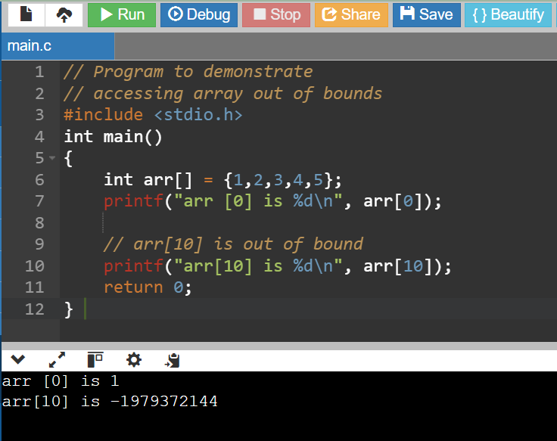
Compile Time or Static Allocation
Inefficient Use of Memory-
  Can cause Overflow in case of under allocation

Slide 7
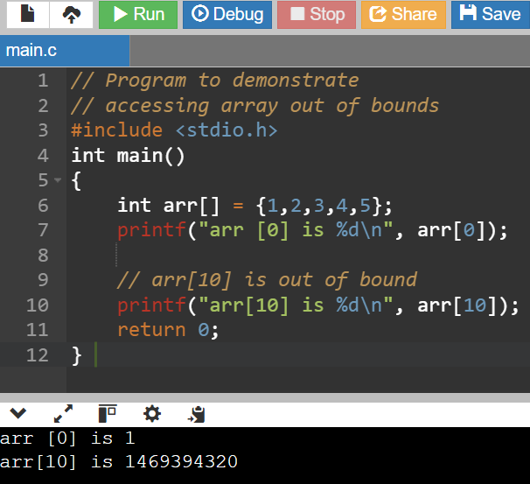
Compile Time or Static Allocation
Garbage Values on Re runs

Slide 8
Compile Time or Static Allocation
Inefficient Use of Memory-
  Can cause Overflow in case of under allocation
    For float a[5];
    No bound checking in C for array boundaries, if you are entering more than fives values,
    It will not give error but when these extra element will be accessed, the values will not be available.

Slide 9
Compile Time or Static Allocation
No reusability of allocated memory
Difficult to guess the exact size of the data at the time of writing the program

Slide 10
Runtime or Dynamic Allocation
All Linked Data Structures are preferably implemented through dynamic memory allocation.
Dynamic data structures provide flexibility in adding, deleting or rearranging data objects at run time.
Managed in C through a set of library functions:
  malloc()
  Calloc()
  free()
  Realloc()

Slide 11
Runtime or Dynamic Allocation
Memory allocation done at the time of execution(run time)
Memory space required by Variables is calculated and allocated during execution
Get Required chunk of memory at Run time or As the need arises
Best Suited –
  When we do not know the memory requirement in advance, which is the case in most of the real life problems.

Slide 12
Runtime or Dynamic Allocation
Efficient use of Memory
  Additional Space can be allocated at run time.
  Unwanted Space can be released at run time.
Reusability of Memory space

Slide 13
The malloc() fn
Allocates a block of memory in bytes
The user should explicitly give the block size needed.

Slide 14
The malloc() fn
Request to the RAM of the system to allocate memory,
  If request is granted returns a pointer to the first block of the memory
  If it fails, it returns NULL

Slide 15
The malloc() fn
The type of pointer is Void, i.e. we can assign it any type of pointer.
Available in header file alloc.h or stdlib.h

Slide 16
The mallloc() fn
Syntax-
ptr_var=(type_cast*)malloc(size)

Slide 17
The mallloc() fn
Syntax-
ptr_var=(type_cast*)malloc(size)
ptr_var = name of pointer that holds the starting address of allocated memory block
type_cast* = is the data type into which the returned pointer is to be converted
Size = size of allocated memory block in bytes

Slide 18
The mallloc() fn
Eg-
int *ptr;
ptr=(int *)malloc(10*sizeof(int));

Slide 19
The mallloc() fn
Eg-
int *ptr;
ptr=(int *)malloc(10*sizeof(int));
Size of int=2bytes
So 20 bytes are allocated,
Void pointer is casted into int and assigned to ptr

Slide 20
The mallloc() fn
Eg-
char *ptr;
ptr=(char *)malloc(10*sizeof(char));

Slide 21
The mallloc() fn- Usage in Linked List
Eg-
struct student;
{
int roll_no;
char name[30];
float percentage;
};
struct student *st_ptr;
st_ptr=(struct student *)malloc(10*sizeof(struct student));

Slide 22
The callloc() fn
Similar to malloc
  It neds two arguments as against one argument in malloc() fn
Eg-
int *ptr;
ptr=(int *)calloc(10,2));
1st argument=no of elements
2nd argument=size of data type in bytes

Slide 23
The callloc() fn
Available in header file alloc.h or stdlib.h

Slide 24
Malloc() vs callloc() fn
Initialization:
malloc() doesn’t initialize the allocated memory.
  If we try to access the content of memory block(before initializing) then we’ll get segmentation fault error(or garbage values).
calloc() allocates the memory and also initializes the allocated memory block to zero.
  If we try to access the content of these blocks then we’ll get 0.

Slide 25
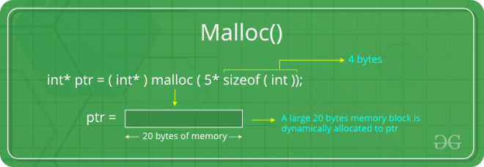
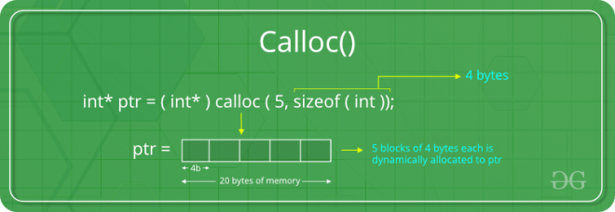
Malloc() vs callloc() fn
Malloc
allocate a single large block of memory with the specified size.
Calloc
allocate multiple blocks of memory
dynamically allocate the specified number of blocks of memory of the specified type.

Slide 26
The free() fn
Used to deallocate the previously allocated memory using malloc or calloc() fn
Syntax-
free(ptr_var);
ptr_var is the pointer in which the address of the allocated memory block is assigned.
Returns the allocated memory to the system RAM..

Slide 27
What happens when you don’t free memory after using malloc()

Slide 28
What happens when you don’t free memory after using malloc()
The memory allocated using malloc() is not de-allocated on its own.
So, “free()” method is used to de-allocate the memory.
But the free() method is not compulsory to use.

Slide 29
What happens when you don’t free memory after using malloc()
If free() is not used in a program
  the memory allocated using malloc() will be de-allocated
  after completion of the execution of the program
  (included program execution time is relatively small and the program ends normally).

Slide 30
What happens when you don’t free memory after using malloc()
Still, there are some important reasons to free() after using malloc():
  Use of free after malloc is a good practice of programming.
  There are some programs like a digital clock, a listener that runs in the background for a long time and there are also such programs which allocate memory periodically.

Slide 31
What happens when you don’t free memory after using malloc()
Still, there are some important reasons to free() after using malloc():
  In these cases, even small chunks of storage add up and create a problem.
  Thus our usable space decreases.
  This is also called “memory leak”.
  It may also happen that our system goes out of memory if the de-allocation of memory does not take place at the right time.

Slide 32
Memory Leak ?
A memory leak is a type of resource leak
that occurs when a computer program incorrectly manages memory allocations
in a way that memory which is no longer needed is not released

Slide 33
The realloc() fn
To resize the size of memory block, which is already allocated using malloc.
Used in two situations:
  If the allocated memory is insufficient for current application
  If the allocated memory is much more than what is required by the current application

Slide 34
The realloc() fn
Syntax-
ptr_var=realloc(ptr_var,new_size);
ptr_var is the pointer holding the starting address of already allocated memory block.
Available in header file<stdlib.h>
Can resize memory allocated previously through malloc/calloc only.

Slide 35
Eg of mallloc() fn
#include <stdio.h>
#include <string.h>
#include <stdlib.h>
int main()
{
char *mem_allocation;
mem_allocation = (char *) malloc( 20 * sizeof(char) );
if( mem_allocation == NULL )
{
printf("Couldn't able to allocate requested memory\n");
}
else
{
strcpy( mem_allocation,"fresh2refresh.com");
}

Slide 36
Eg of mallloc() fn
printf("Dynamically allocated memory content : "%s\n", mem_allocation );
mem_allocation=realloc(mem_allocation,100*sizeof(char));
if( mem_allocation == NULL )
{
printf("Couldn't able to allocate requested memory\n");
}
else
{
strcpy( mem_allocation,"space is extended upto 100 characters");
}
printf("Resized memory : %s\n", mem_allocation );
free(mem_allocation);
}

Slide 37
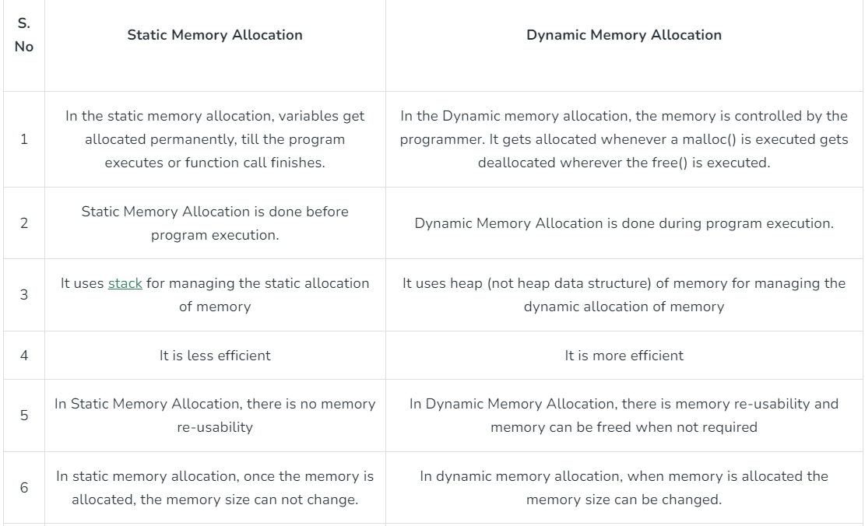

Slide 38
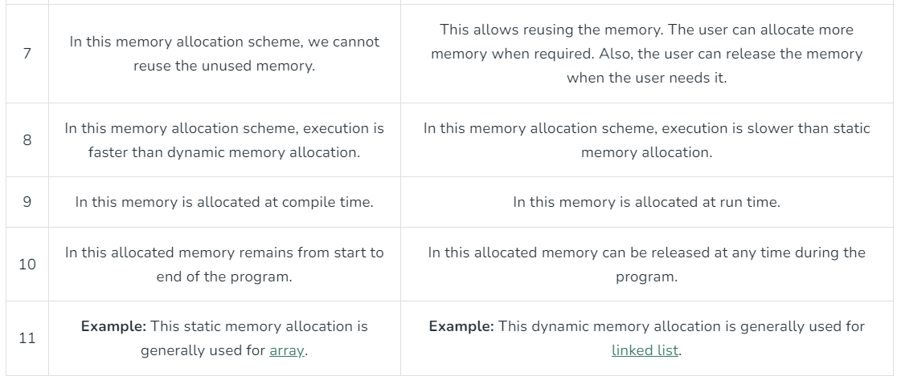

Slide 39
Pointers and arrays
Allocating individual integers isn't all that useful either. But malloc() can also allocate arrays. We will discuss the similarity of pointers and arrays in class, and the textbook discusses this in section 3.13. But essentially, a pointer can be used as an array, and you can index it just like an array, as long as it is pointing to enough memory. The following example demonstrates this:
int *ip;
ip = (int *) malloc( sizeof(int)*10 ); // allocate 10 ints
ip[6] = 42; // set the 7th element to 42
ip[10] = 99; // WRONG: array only has 10 elements
(this would corrupted memory!)

Slide 40
Which part of the memory is allocated when static memory allocation is used, for int,char,float,arrays,struct,unions…..?
Which part of the memory is allocated when malloc and calloc are called for any variable?
??

Slide 41
Stack
Basic type variables such as int, double, etc, and complex types such as arrays and structs. These variables are put on the stack in C.
There is a limit (varies with OS) on the size of variables that can be stored on the stack.
This is not the case for variables allocated on the heap
https://sites.ualberta.ca/dept/chemeng/AIX-43/share/man/info/C/a_doc_lib/aixprggd/genprogc/sys_mem_alloc.htm

Slide 42
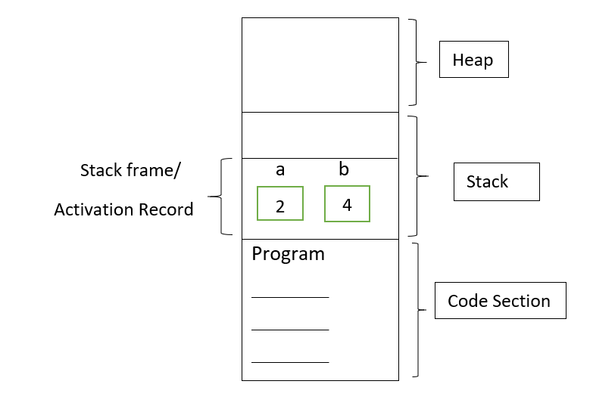
Stack
#include <iostream>
using namespace std;
// Driver Code
void main()
{
int a; // 2 bytes
long b; // 4 bytes
}
https://www.geeksforgeeks.org/static-and-dynamic-memory-allocation-in-c/

Slide 43
Heap
The heap is a region of your computer's memory that is not managed automatically for you, and is not as tightly managed by the CPU.
It is a more free-floating region of memory (and is larger).
Dynamic memory allocation functions allocates memory from the heap.

Slide 44
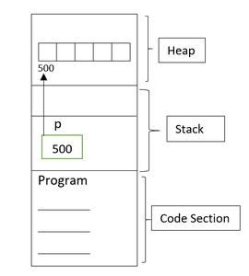
Stack
#include <iostream>
using namespace std;
// Driver Code
void main()
{
int* p; // 2 bytes
P = (int*)malloc(5 * sizeof(int));
}
https://www.geeksforgeeks.org/static-and-dynamic-memory-allocation-in-c/

Slide 45
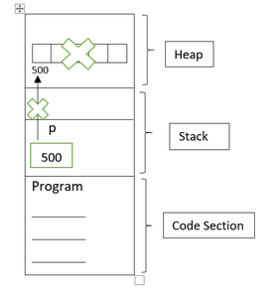
Stack
#include <iostream>
using namespace std;
// Driver Code
void main()
{
int* p; // 2 bytes
P = (int*)malloc(5 * sizeof(int));
free(p);
p=NULL;
}
https://www.geeksforgeeks.org/static-and-dynamic-memory-allocation-in-c/

Slide 46
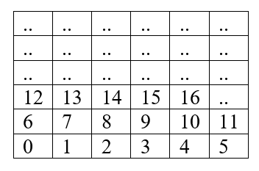
Memory is divided into smaller addressable units called bytes.
Assume that these are small boxes as bytes.
Each byte has its own address as per the below table. For example: 0, 1, 2, 3, 4, 5, 6, etc.

Slide 47
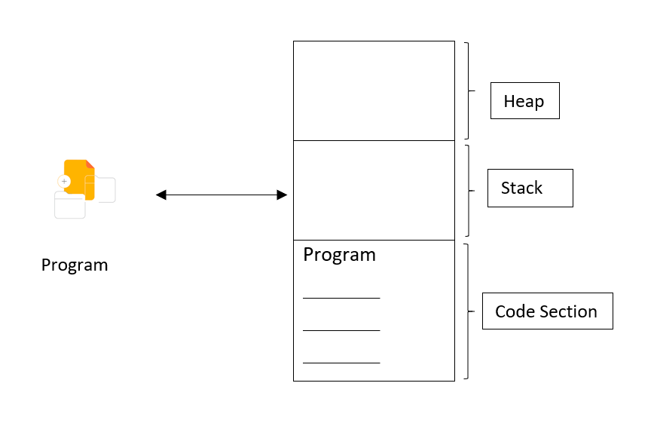
The Memory is divided into three sections.
Heap Memory
Stack Memory
Code Section
How program uses memory?

Slide 48
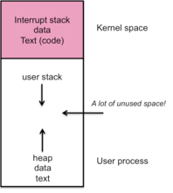
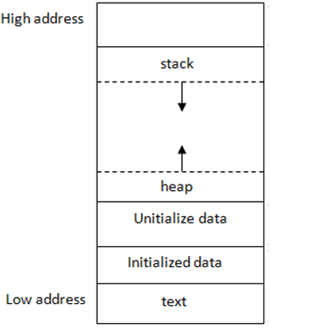
Stack and Heap
Stack and Heap both stored in the computer's RAM .

Slide 49
Heap
To allocate memory on the heap, you must use malloc() or calloc(), which are built-in C functions.
Deallocate memory on heap using free
If you fail to do this, your program will have what is known as a memory leak. That is, memory on the heap will still be set aside (and won't be available to other processes).

Slide 50
Stack vs Heap
Heap –
You must manage memory (you're in charge of allocating and freeing variables)
The heap does not have size restrictions on variable size (apart from the obvious physical limitations of your computer).
Heap memory is slightly slower to be read from and written to, because pointers are used to access memory on the heap.
Variables can be resized using realloc()
variables can be accessed globally
Stack –
Don't have to explicitly de-allocate variables
The stack has size limits
very fast access
variables cannot be resized
local variables only
https://gribblelab.org/CBootCamp/7_Memory_Stack_vs_Heap.html

Slide 51
Stack
Stack resident variables are:
  created (“pushed on to”) the stack when a basic block that contains them (i.e. function) is activated and
  disappear from (“popped off”) the stack when the function is done
    (Those areas of memory that had been used by variables when a basic block was activated may then be overwritten after exit from the block.)
  stack memory is more limited, i.e. there is less of it compared to heap memory
http://citeseerx.ist.psu.edu/viewdoc/download;jsessionid=13D3E255880D543426E53785A6A7895F?doi=10.1.1.705.51&rep=rep1&type=pdf

Slide 52
Heap
Heap resident variables include:
  variables declared outside all functions (globals)
  variables declared inside basic blocks that are declared static
  memory areas dynamically allocated at run time with malloc( )
Storage for declared heap resident variables is:
  assigned at the time a program is loaded, and
  remains assigned for the life of a program

Slide 53
Linked List

Slide 54
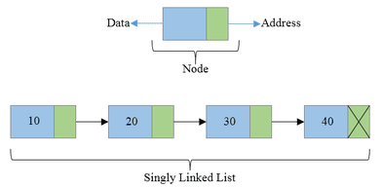
Linked Lists
Linear Collection of data elements called Nodes
Linear order is given by means of pointers.

Slide 55
Linked Lists
Each node may be divided into atleast two fields for :
  Storing Data
  Storing Address of next element.

Slide 56
Linked Lists
The Last node’s Address field contains Null rather than a valid address.
It’s a NULL Pointer and indicates the end of the list.

Slide 57
Comparison between Array and Linked List

Slide 58
Advantages of Linked List
Linked are Dynamic Data Structures
  Grow and shrink during execution of the program
Efficient Memory Utilization
  As memory is not preallocated.
  Memory can be allocated whenever required and deallocated when not needed.
Insertion and deletions are easier and efficient
  Provide flexibility in inserting a data item at a specified position and deletion of a data item from the given position
Many complex applications can be easily carried out with linked lists

Slide 59
Disadvantages of Linked List
Access to an arbitary data item is little bit cumbersome and also time consuming
More memory
  If the number of fields are more, then more memory space is needed.

Slide 60
Advantages of Arrays
Simple to use and define
Supported by almost all programming languages
Constant access time
  Array element can be accessed a[i]
Mapping by compiler
  Compiler maps a[i] to its physical location in memory.
  This mapping is carried out in constant time, irrespective of which element is accessed

Slide 61
Arrays suffer from some severe limitations
Disadvantages of Arrays
Static Data Structure-
  Size of an array is defined at the time of programming
Insertion and Deletion is time consuming
Requires Contiguous memory

Slide 62
Types of Linked List
Singly Linked List
Doubly Linked List
Circular Linked List

Slide 63
Singly Linked List
All nodes are linked in sequential manner
Linear Linked List
One way chain
It has beginning and end

Slide 64
Singly Linked List
Problem-
  The predecessor of a node cannot be accessed from the current node.
  This can be overcome in doubly linked list.

Slide 65
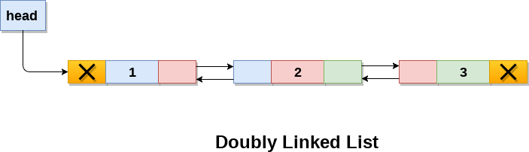
Doubly Linked List
Linked List holds two pointer fields
Addresses of next as well as preceding elements are linked with current node.
This helps to traverse in both Forward or Backward direction

Slide 66
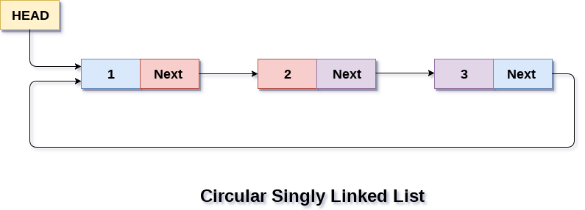
Circular Linked List
The first and last elements are adjacent.
A linked list can be made circular by
  Storing the address of the first node in the link field of the last node.

Slide 67
Linked List Operations
Creation
Insertion
Deletion
Traversal
Searching

Slide 68
Implementation of Linked Lists
Structures in C are used to define a node
Address of a successor node can be stored in a pointer type variable

Slide 69
Linked Lists
Struct Basics
Struct Syntax
Struct examples
Pointer to structure
Sample Programs for Pointer to structures
Initialization of Pointers to Structures

Slide 70
Linked Lists
Information field
struct node
{
int info;
struct node *link;
}
Pointer that points to the structure itself,
Thus Linked List.

Slide 71
Singly Linked List

Slide 72
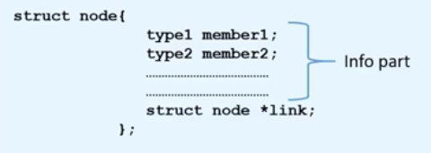
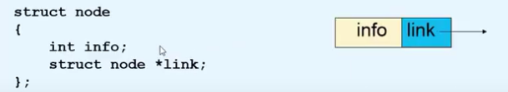

Creation of a new node

Slide 73
Creation of a new node
New node=temp
struct node *tmp;
tmp= (struct node *) malloc(sizeof(struct node));
tmp->info=data;
tmp->link=NULL;

Slide 74
Creating a Linked List
create_list(int data)
{
struct node *q,*tmp;
tmp= (struct node *) malloc(sizeof(struct node));
tmp->info=data;
tmp->link=NULL;
if(start==NULL) /*If list is empty */
{
start=tmp;
}
else
{ /*Element inserted at the end */
q=start;
while(q->link!=NULL)
{
q=q->link;
}
q->link=tmp;
}
}/*End of create_list()*/

Slide 75
Explanation-
if(start==NULL) /*If list is empty */
{
start=tmp;
}

Slide 76
Explanation-
else
{ /*Element inserted at the end */
q=start;
while(q->link!=NULL)
{
q=q->link;
}
q->link=tmp;
}

